Slide 1
Range Tree-Linked List Hierarchical Search
Structure for Packet Classification on FPGAs
Authors : Oguzhan Erdem and Aydin Carus
Publisher :Reconfigurable Computing and FPGAs (ReConFig), 2013 International Conference on
Presenter : Kai-Hsun Li
Date : 2015/8/12
Department of Computer Science and Information Engineering
National Cheng Kung University, Taiwan R.O.C.
Notes:
1

Slide 2
Introduction
Pipelined hardware implementation of Hierarchical algorithms has two disadvantages: (1) backtracking which requires stalling the pipeline and (2) inefficient memory usage.
In this paper, two stage Range-tree Linked-list Hierarchical search Structure (RLHS) is introduced for packet classification.
Notes:
Backtracking實做在硬體上需要stalling pipeline
Memory inefficiency則是因為實做在硬體上時，node無法動態配置memory，
只能依照最大的node來建trie，因此造成memory的浪費

Slide 3
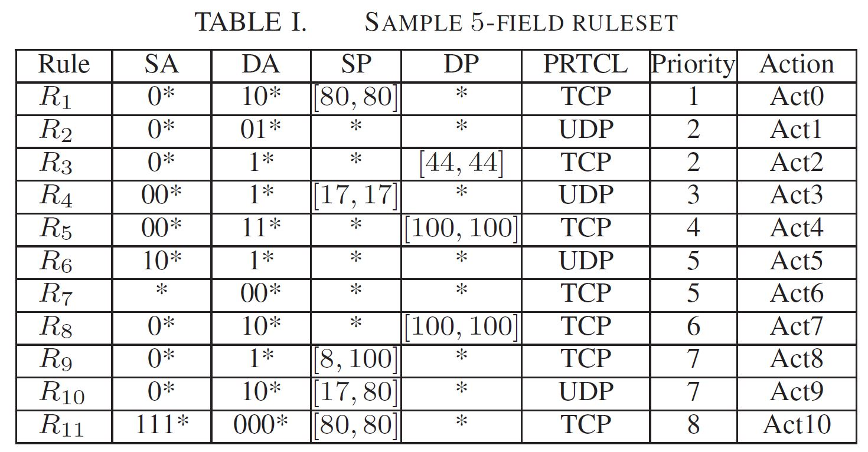
Related Work

Slide 4
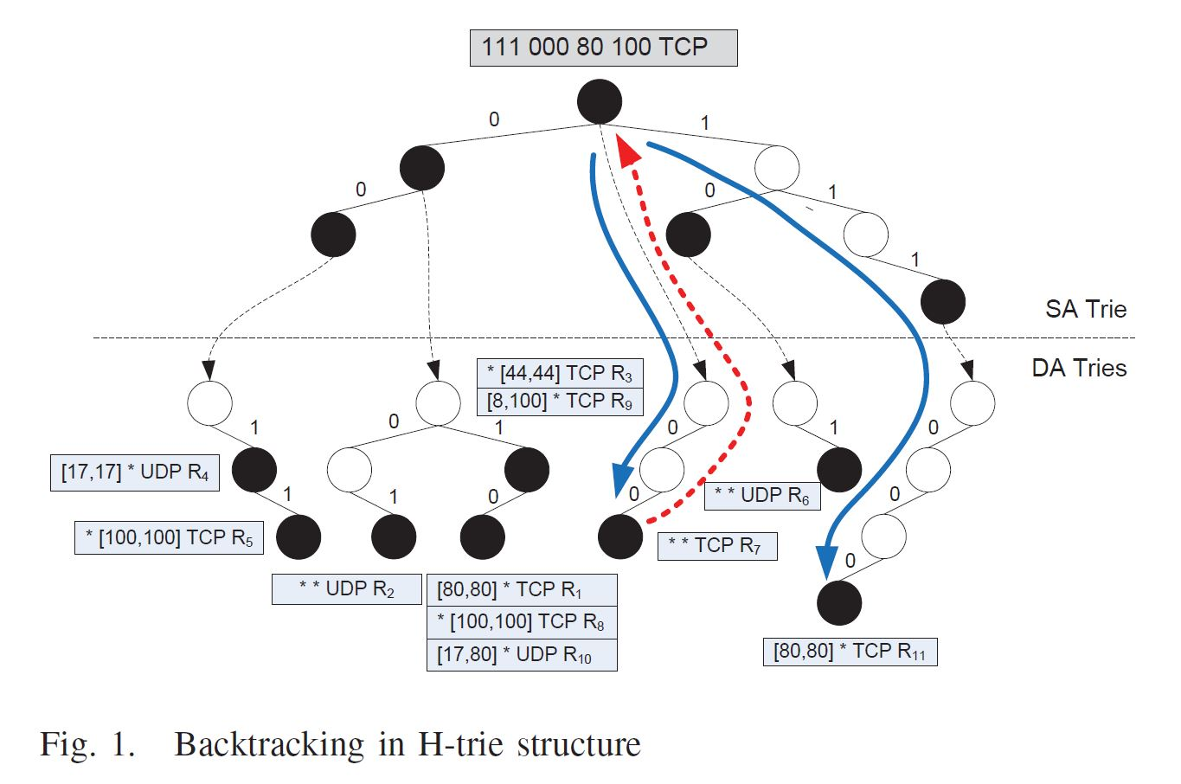
Related Work

Slide 5
Proposed Scheme(1/4)
We propose a hierarchical search structure which consists of 2 stages:
  Range tree(RT) stage
  Linked list(LL) stage
Before construct RT stage, we first partition the ruleset.

Slide 6
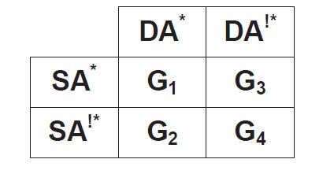
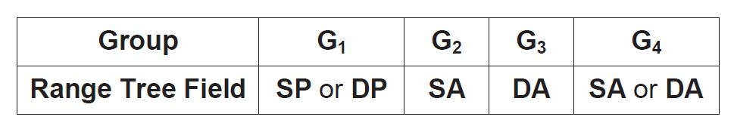
Proposed Scheme(2/4)
-Grouping
Step 1 of partitioning
Rule fields used for constructing RTs

Slide 7
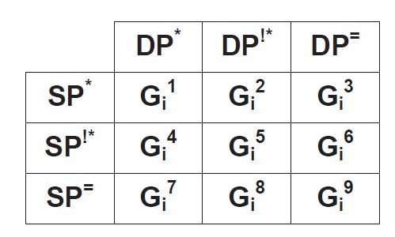
Proposed Scheme(2/4)
-Grouping
Step 2 of partitioning
Notes:
剛剛step1分出來的group都可以再細分出這9個sub-group，因此一共會有36個sub-gruoup
再利用這36個group來建tree

Slide 8
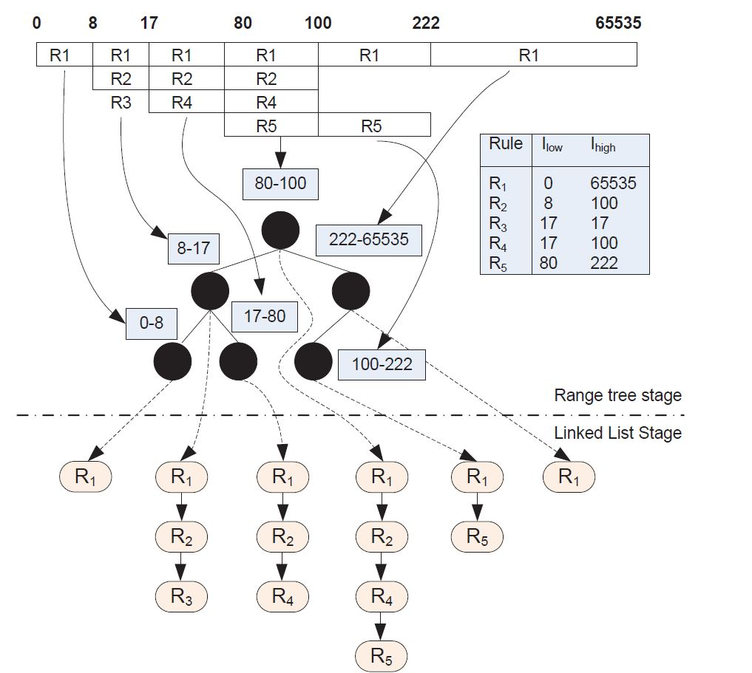
Proposed Scheme(3/4)
Notes:
這個例子的rule table在右邊，
RT的部份跟dynamic segment tree一樣，但此部份就只存range的upper及lower bound
LL的部份則是將match該段range的rules串起來

Slide 9
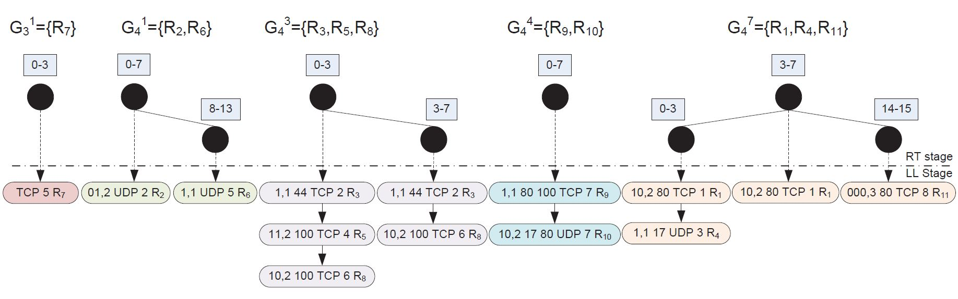
Proposed Scheme(4/4)
Range tree-Linked list Hierarchical Search Structure for the ruleset in Table I
Notes:
這是利用剛剛的rule table建出來的RLHS，$G_{4}^{1}的LL stage中，存的是$DstIP、DstLen、proto、priority

Slide 10
Proposed Scheme(4/4)

Slide 11
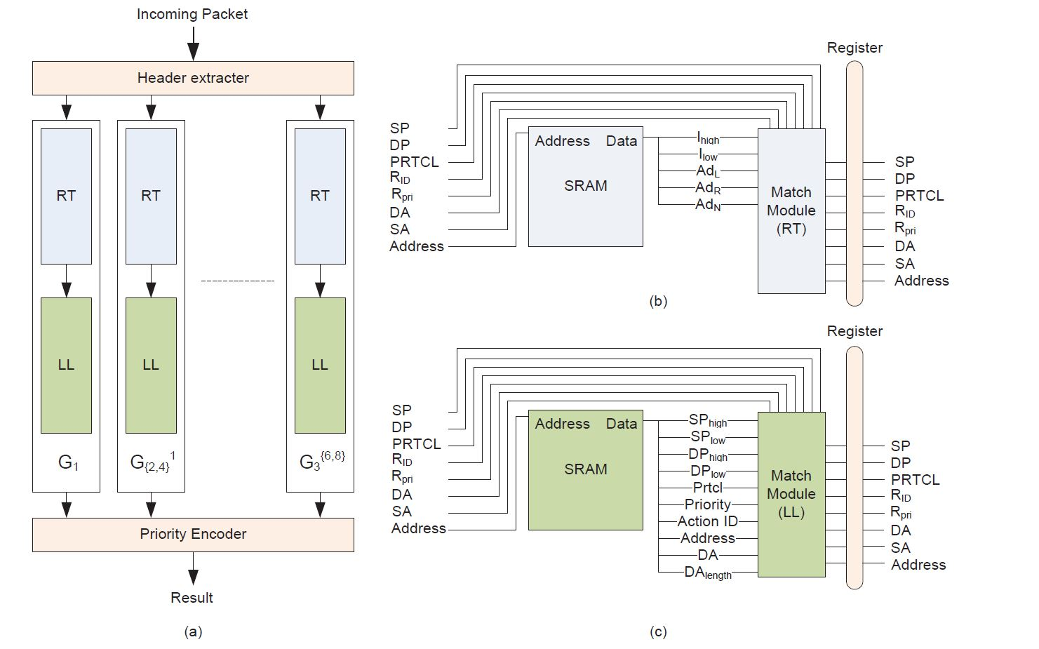
ARCHITRCTURE
Notes:
右上是RT pipeline，右下是LL pipeline
Ilow: lower bound of interval
Ihigh: upper bound of interval
Adn: next stage pointer

Slide 12
OPTIMIZATION(1/3)
Optimizations on categorization and RLHS algorithm to further ameliorate memory and resource efficiencies.
  Merge Group
  Merged Interval

Slide 13
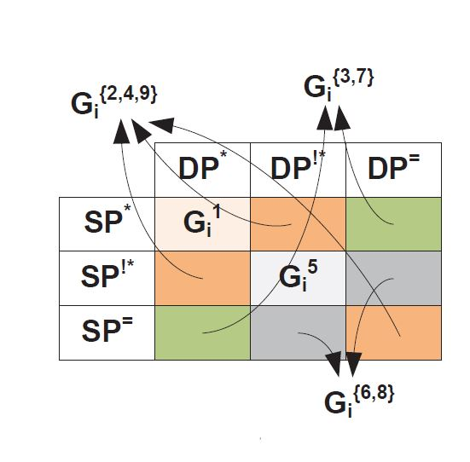
OPTIMIZATION(2/3)
-Merge Group
STEP 1
G1 : cancel step2
G{2,4} : G2 and G4 merge
into a single group
G3 : not change
STEP 2
Notes:
Paper觀察到:rule被分類到G1、G2的數量相對較少，因此決定將G2、G4合併成一個group；G1則不再繼續細分sub-group
(G2跟G4合併是因為建range tree 時，都會用到SA)
因此現在只剩3種group

Slide 14
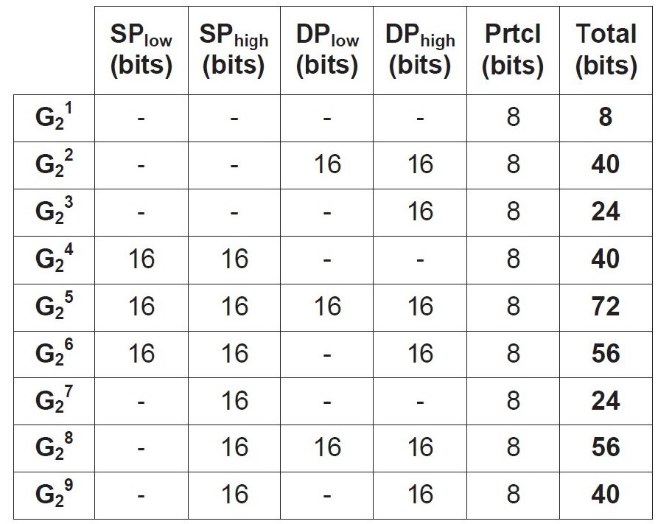
OPTIMIZATION(2/3)
-Merge Group
STEP 2
The number of data bits in a LL node for the sub-rulesets
Notes:
而sub-group的部份，所需要紀錄的total bits數相同，所以將$G_{i}^{\{2,4,9\}}將G_{i}^{2}$、$G_{i}^{4}$、$G_{i}^{9}$ sub-group合併再一起，同理$G_{i}^{\{3,7\}}、G_{i}^{\{6,8\}}$，
因此現在只剩5個sub-group
而全部的sub-group的數量從36降為11(1是因為G1不再細分sub-group)

Slide 15
OPTIMIZATION(2/3)
-Merge Group
STEP 2
The number of data bits in a LL node for the sub-rulesets
Notes:
而sub-group的部份，所需要紀錄的total bits數相同，所以將$G_{i}^{\{2,4,9\}}將G_{i}^{2}$、$G_{i}^{4}$、$G_{i}^{9}$ sub-group合併再一起，同理$G_{i}^{\{3,7\}}、G_{i}^{\{6,8\}}$，
因此現在只剩5個sub-group
而全部的sub-group的數量從36降為11(1是因為G1不再細分sub-group)

Slide 16
OPTIMIZATION(2/3)
-Merge Group
STEP 2
The number of data bits in a LL node for the sub-rulesets
Notes:
而sub-group的部份，所需要紀錄的total bits數相同，所以將$G_{i}^{\{2,4,9\}}將G_{i}^{2}$、$G_{i}^{4}$、$G_{i}^{9}$ sub-group合併再一起，同理$G_{i}^{\{3,7\}}、G_{i}^{\{6,8\}}$，
因此現在只剩5個sub-group
而全部的sub-group的數量從36降為11(1是因為G1不再細分sub-group)

Slide 17

OPTIMIZATION(3/3)
-Merged Interval
80-100
$P_{D}$ = 4
8-17
222-65535
0-8
17-80
100-222
R1
R1
R1
R1
R1
R1
R2
R2
R5
R2
R4
R3
R4
R5

Slide 18
OPTIMIZATION(3/3)
-Merged Interval
80-100
$P_{D}$ = 4
8-80
222-65535
0-8
100-222
R1
R1
R1
R1
R1
R2
R2
R5
R3
R4
R4
R5

Slide 19
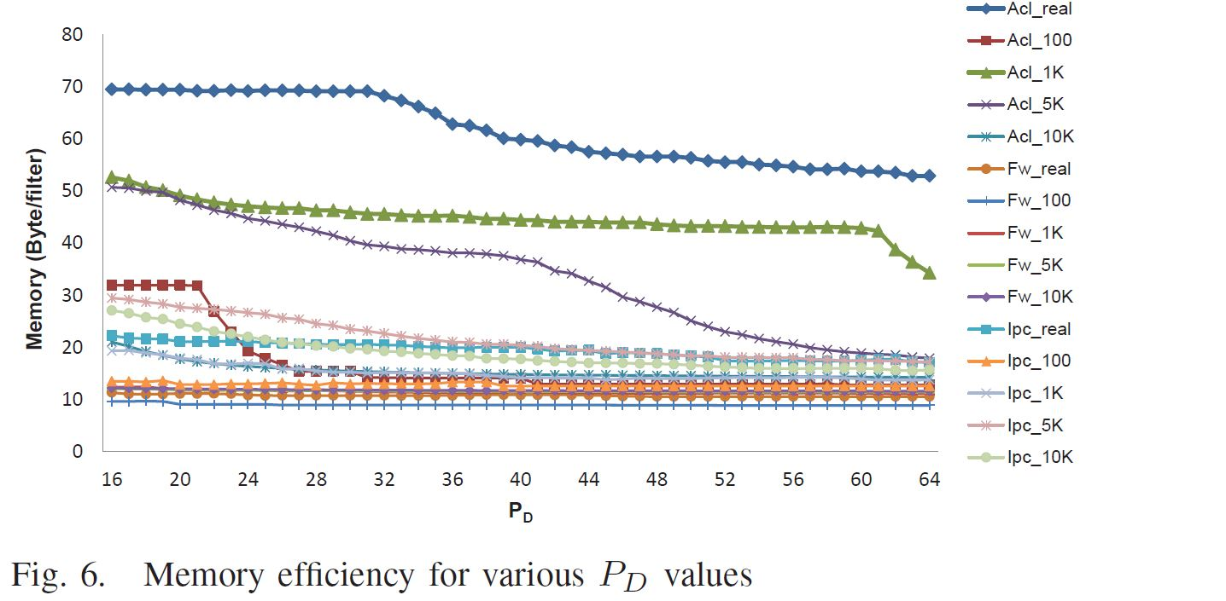
EXPERIMENTAL RESULT(1/3)
Notes:
使用的板子是Virtex-6
Pd是LL的深度上限，假如rule數量超過Pd時，剩下的rule就會儲存至TCAM中

Slide 20
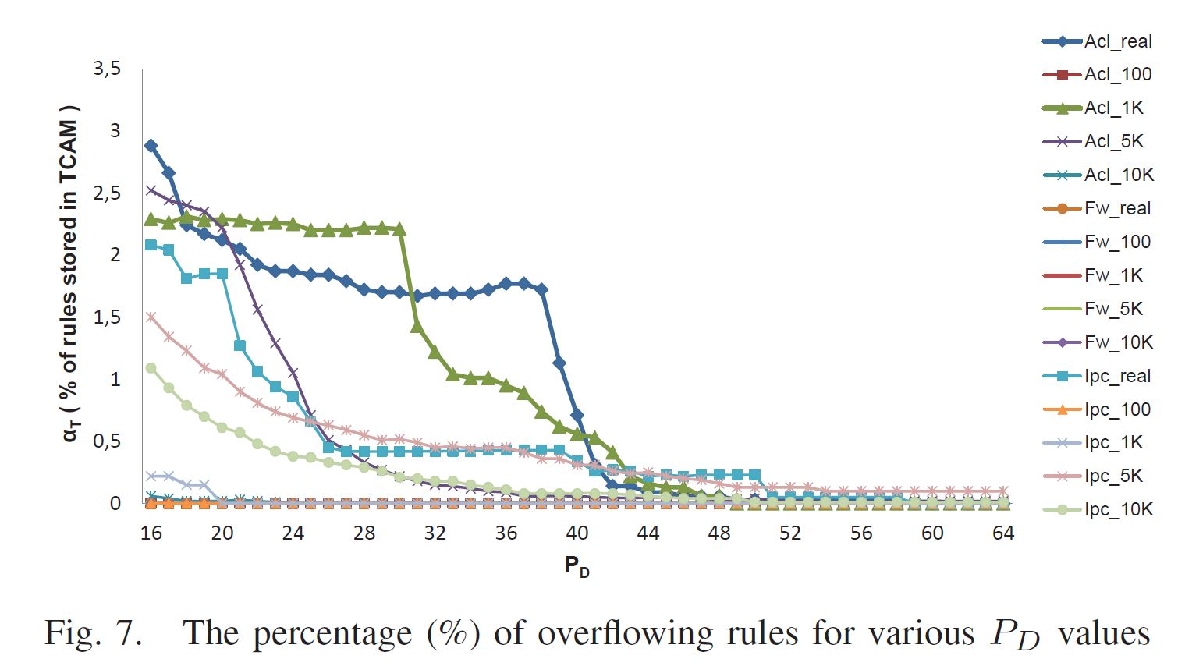
EXPERIMENTAL RESULT(2/3)
Notes:
Alpha t是儲存在TCAM的比例
這個是Pd跟alpha t的關係圖
Pd=40，alpha t<1%

Slide 21
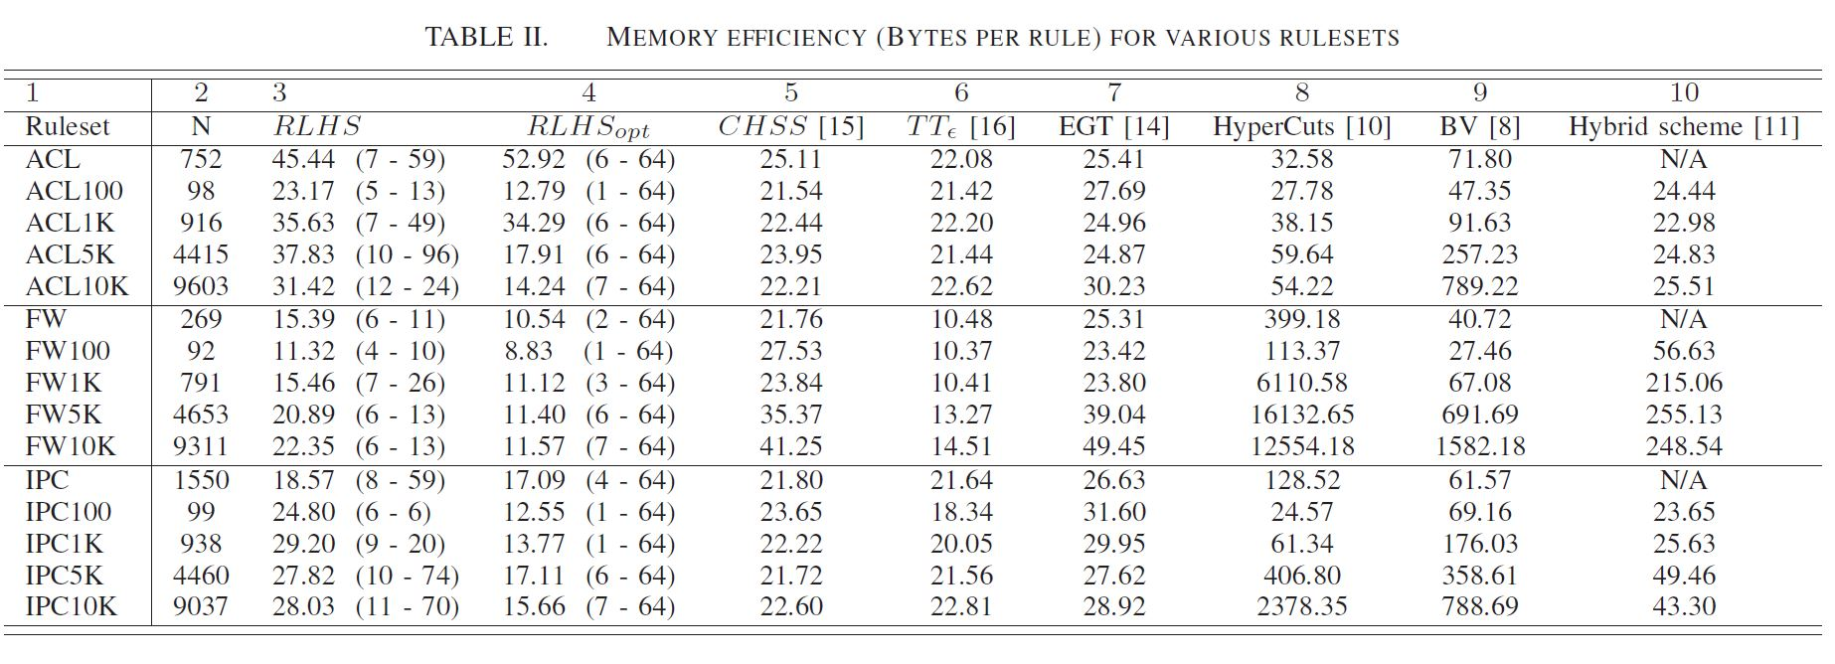
EXPERIMENTAL RESULT(3/3)
Notes:
括號裡，左邊的數字是RT的深度，右邊的是LL的深度

